Slide 1

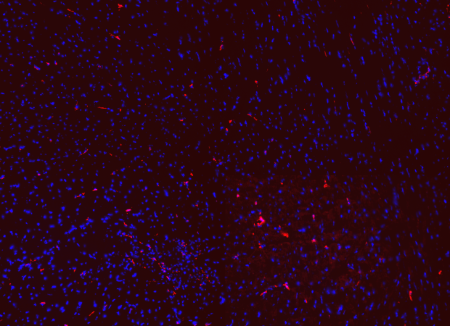
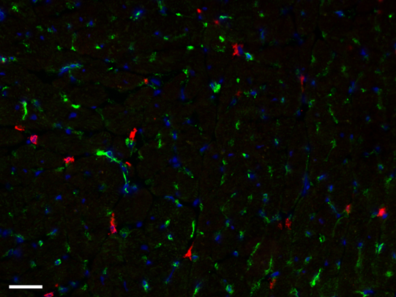
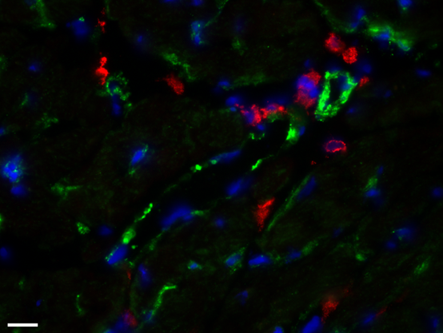
ReliaTech GmbH
Cross reactivity of anti-mouse Lyve1 with rat tissue
(Cat #103-PA50AG)
A
B
C
D
Fig. 1: Rat cardiac lymphatic microvessels, labeled with antibodies against mouse LYVE-1 (red), and adjacent blood vessels, labeled with antibodies against CD31 (green). Nuclear stain in blue. Images were obtained at 10x magnification on a Zeiss fluorescence microscope. Scale bar = 100 µm (A,B); 20x and 40x magnification, Scale bar = 50 µm (C,D). Note: The anti-mouse Lyve-1 polyclonal antibody (Cat# 103-PA50AG) shows a strong cross reaction with rat LYVE-1 protein.
The experiment was performed by the research group INSERMU1096 in Rouen, France directed by Dr Vincent Richard.
http://www.reliatech.de / orders@reliatech.de

